Slide 1

Research Methods in Computing and Technology CT098-3-2
Introduction to the module

Slide 2
Module Pre-requisites
A course of study comparable to Level 1 and Level 2 in
Information Technology
Applied Technology
Technology and
Interactive Entertainment Technology

Slide 3
Learning Outcomes
At the end of this module, YOU should be able to:
Demonstrate, create and interpret knowledge in the area of Computing and Technology based on appropriate techniques of research applied.
Critically evaluate current research areas and / or related existing solutions to assist in selecting Final Year Project title.
Demonstrate the ability to formulate and justify the purpose of appropriate research questions in the area of Computing and Technology
Produce a detailed research proposal for Computing and Technology that includes :
Specific and achievable aims / objectives
An appropriate research plan for the project

Slide 4
Topics we will cover
Introduction to disciplines
Research & Literature searches
Idea Generation and Title Selection
Ethics in Research
Reviewing the Literature
Formulating Research Questions
Sampling
Survey
Interview
Observation
Other research methods
Data Analysis

Slide 5
What is expected of you
Attendance & Punctuality
Participation in class-work
Observe rules and regulations
Advice of Study Strategies & Skills

Slide 6
What support is available for you
Module
Student Assessment Information Sheet
Slides
Assignment
In-course Marks
Consultation hours: confirm by email
Email: baharulislam.md@apu.edu.my
Resources
Reference materials
Internet resources

Slide 7

How you will be assessed
A Individual Research Proposal, assessed at 100% (LO 1 – 4)
Detail is coming soon (Week 2/3)

Slide 8
References
Essential Reading
Oates, B.J., (2010), Researching Information Systems and Computing, SAGE Publications Ltd, ISBN-978-1-4129-0224-3
Dawson, C.W., (2009), Projects in Computing and Information Systems, A Student’s Guide, 2nd Edition, Pearson Education Ltd, ISBN-978-0-273-72131-4

Slide 9


References

Slide 10
Resources
ATHENS
URL: http://www.openathens.net/
Students should have an account and an email notification has been sent to the students Webmail at the beginning of Level 2
students are to check webmail first before requesting for an existing Athens account
If you do not have an Athens account, you should request it from (librarian)

Slide 11
Resources
ACM (Association of Computing Machinery)
URL: http://dl.acm.org/dl.cfm
No username or password required (IP address based login)
Can be accessed on campus (ENT3, Main Building, Incubator-2

Slide 12
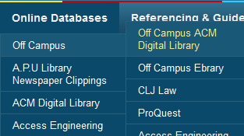
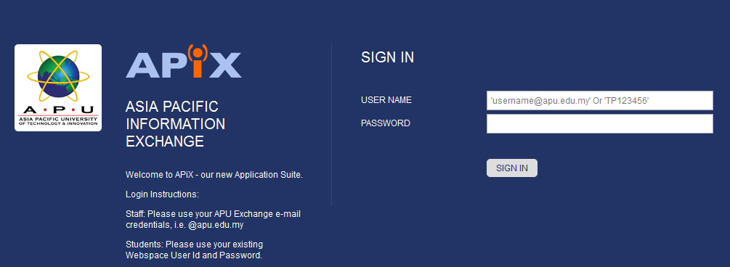
ACM – Off Campus Access

Slide 13
Resources
IEEE (Institute of Electronic and Electrical Engineering)
URL: http://ieeexplore.ieee.org/Xplore/home.jsp
Students can obtain the username and password from any librarian on duty in the library

Slide 14
Resources
Note: Students are to utilize these sources in their work. Remind them that at least 70% of the sources used in the assignment should come from academically accepted and reviewed sources and the remainder can be from websites or whitepapers, excluding blogs and public forums.

Slide 15
Other Resources & Support
Support Facebook Page – UCTI IT FYP
Module Announcements, including FYP
Topic Ideas (posted by different lecturers in the group)
Not specific title is given but a general topic idea in a particular discipline
It is up to you as a student, to further develop on the proposed idea given
Contains links to additional Open Access Journals for different disciplines

Slide 16
Question and Answer Session
Q & A

Slide 17
What we will cover next
Introduction to disciplines:
The nature of Computing & Technology research
Differences between disciplines
Topics of interest within each discipline

